Slide 1
Guaranteed Issue Whole Life Insurance (GIWL)
Policies issued by American General Life Insurance Company (AGL), Houston, TX, member of American International Group, Inc. (AIG).
Notes:
Welcome. Today we are going to cover our Guaranteed Issue Whole Life, final expense product. My name is Trevor Keeble, Director of Product Training here at AIG.
This GIWL product comes coupled with a proprietary electronic processing system that provides faster quoting, applications, policy delivery, and access to forms. In this presentation today we will cover the specs for this product, we will look at the competitive positioning against other similar products, and I will give an overview of the electronic processing system and the different ways available to submit an application.

Slide 2
Who needs GIWL?
81
41
50
%
PAYING for burial/ final expenses is the top reason for owning life insurance.*
MILLION
consumers say they need life insurance, but do not have it.*
MILLION
Americans intend to buy life insurance with long-term care.*
* Insurance Barometer Study, 2020
Notes:
81% of consumers say that the reason for owning life insurance is to pay for their burial costs and final expenses.
41 Million consumers say they need life insurance, but do not have it.
50 Million Americans intend to buy life insurance with long-term care.

Slide 3
Reasons to buy GIWL
Client prefers not to take a medical exam
Desire for permanent protection – i.e., won’t go away in 10, 15, or 20 years
Client doesn’t want to burden others with final expenses
An additional, easy to get, modest legacy for loved ones
Client living on fixed income who requires non fluctuating payments
Notes:
Here are some reasons to buy this type of product. It is appropriate for that client who prefers to not take a medical exam or those who desire permanent protection that won’t go away, like term insurance, in say 10, 15, or 20 years.
For that client who doesn’t want to burden others with final expenses. This product type is also an additional, easy to get, modest legacy for loved ones.
And may be right for those clients who are living on a fixed income who requires non-fluctuating payments.

Slide 4
GIWL competitive product
Guaranteed issue, no medical questions
Graded Death Benefit Whole Life
Attractive Chronic Illness Acceleration
Benefit at no additional cost*
Terminal Illness Benefit Included*
Face Amounts $5,000 - $25,000
Ages 50-80 (ALB)
Years 1-2 110% of premiums paid
Years 3 Full Face Amount
Accidental Death Full Face Amount
Returns 100% of premiums paid, up to 25% of Face Amount
No waiting period
One-time lump sum payment when insured becomes chronically ill (2 out of 6 ADLs)
50% of Death Benefit within 24-month life expectancy or less
*Riders not available in all states
Notes:
Let’s talk specifically about the Guaranteed Issue Whole Life product from AGL.
First of all, this is a guaranteed issue product so there are no underwriting questions for this product, there are not medical questions, there are no medical exams needed for the product issuance. The face amounts available are $5,000 up to $25,000 and the issue ages are 50 to 80 and it is calculated based off age last birthday.
It is a graded death benefit whole life product which means in years 1 and 2, if the insured were to pass away, the beneficiary would receive 110% of premiums that had been paid into the policy.
In years 3 and beyond the full face amount would be paid and if the death of the insured was due to an accidental death the full face amount will be paid.
From an underwriting standpoint, the available is simply a standard, sex distinct, unismoke rate. There are no substandard classes. Also note: Foreign nationals will not be allowed to purchase this product.
What makes it very attractive is the 2 benefits that are automatically included. The first is a chronic illness accelerated benefit that is available at no additional cost. This benefit returns 100% of premiums paid, up to a maximum of 25% of the face amount. With this chronic illness benefit there is no waiting period and it pays out benefits in one lump sum. In order to activate this benefit the insured would need to be chronically ill, meaning unable to perform 2 out of the 6 activities of daily living or suffering from a severe cognitive impairment.
Also included in this product for no additional charge is a terminal illness benefit that provides 50% of the death benefit if the insured has a life expectancy of 24 months or less.
All issues for this product will be an instant-issue decision.
Policy Loans are allowed. The Effective Annual Loan Interest Rate = 8%, payable in arrears.
Free Look 30 Days
Grace Period 31 Days
Single Premium Not Available

Slide 5
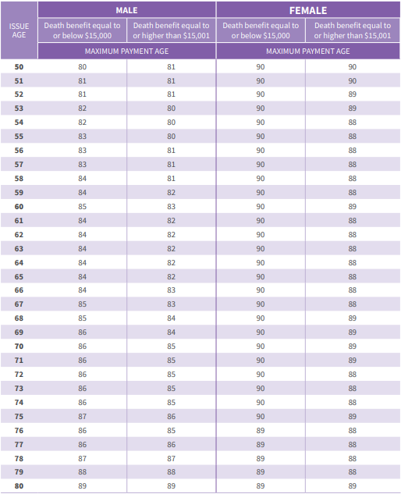
Maximum payment age
Premiums will be required to be paid to the maximum age shown in the chart to the right.
Maximum payment age varies by age, gender, and face amount.
Premiums paid may exceed amount of coverage. For an estimate of the year the premiums may exceed the amount of coverage, divide the face amount by annual premium.
Notes:
(Read Slide)

Slide 6
GIWL product requirements
Product Requirements
Insured must be Owner
Payor can be different than Insured
Social Security number will be required
Only one policy per Owner/Insured in a twelve-month period
Insured can get no more than $25k total in GI insurance from American General Life Insurance
No replacement or conversion into this product allowed
Payment options include bank draft, credit card, and social security debit card
Payment date can be scheduled to match policy effective date on bank draft only
Notes:
Some other requirements to be aware of with this GIWL product:
The insured must be the owner
The payor though can be different than the insured. (Again note that foreign nationals are not allowed to purchase this product and foreign nationals are not allowed to be the payor either)
From an application standpoint, the social security number is required.
Only one policy is allowed per owner/insured in a twelve month period and the insured can get no more than $25k in total of guaranteed issue insurance from American General.
So, they could purchase a $10k policy this year and after 12 months goes by they could apply and purchase another policy, say $15k, and that would give them their total $25k maximum aggregate guaranteed issue life insurance from American General then they could not purchase any more.
There are no replacements or conversions allowed into this product.
And the payment options available include bank draft, credit card, and a social security debit card. Payment date can be scheduled to match policy effective date on bank draft only. We will take a look at the application and electronic process in a little bit to see how you do that.
*Direct billing not available even though it may be an option on the application.

Slide 7
GIWL chargeback rules
Lapse and surrenders (year 1 only)
Months 1-6: 25%
Months 7-12: N/A
Death (years 1-2)
Year 1: 100%
Year 2: 50%
Notes:
Do note that there are chargeback rules in place for this product. The chargebacks on lapse and surrenders apply for year one only. If the lapse is in months 1-6 there is a 25% commission chargeback. After 6 months there is no chargeback for lapse.
For death, there is a 100% chargeback if the insured dies in year 1 and a 50% chargeback if they die in year 2.

Slide 8
GIWL competitive product analysis
As of February 5, 2021
 | American General | Americo | Gerber | John Hancock | Mutual of Omaha | New York Life
Product Name | Guaranteed Issue Whole Life | Eagle Guaranteed | Guaranteed Life Insurance | Final Expense | Whole Life Guaranteed | Easy Acceptance Life Insurance
Coverage Available | $5,000 to $25,000 | $5,000 to $10,000 | $5,000 to $25,000 | $2,000 to $20,000 | $5,000 to $25,000 | $2,500 to $25,000
Issue Ages | 50 to 80 | 50 to 80 | 50 to 80 | 55 to 80 | 40 to 85 | 50 to 80
Graded Benefit Coverage | 110% of premiums paid, first two years | Year 1 - ROP plus 5% Year 2 - ROP plus 10% Year 3 - 75% of the face amount | Premiums paid plus 10% interest compounded annually, first two years | 110% of premiums paid, first two years | 110% of premiums paid, first two years | 125% of premiums paid, first two years
Chronic Illness Benefit | Premiums paid are returned up to 25% of face No waiting period | ------ | ------ | ------ | ------ | ------
Terminal Illness Benefit | 50% of death benefit with 24-month life expectancy | ------ | ------ | ------ | ------ | 50% of death benefit with 12-month life expectancy
Carriers mentioned in the presentation are peer group competitors of AGL. Every attempt has been made to verify the accuracy of competitor information. Product and rates are subject to change at any time.
Carriers mentioned in the presentation are peer group competitors of AGL. Every attempt has been made to verify the accuracy of competitor information. Product and rates are subject to change at any time.
Notes:
Mutual of Omaha sells two very similar products in different channels. The one here is the one sold through AGL Direct. The New York Life product is marketed through AARP, as their very similar unbranded product is not sold any longer.
Our product has a maximum face amount of $25,000, which is as large as any other product in the GIWL space.
But the things that really separate our product from the competition are the two rows at the bottom. The chronic illness and terminal illness benefits that are included automatically on our GIWL product. The issue of chronic illness and how to pay for it is certainly a major concern for seniors and a selling point of our product. To note, with the September 2018 reprice, its benefit has been reduced to a maximum of 25% rather than 50% of premiums paid.

Slide 9
GIWL competitive pricing – monthly premiums
As of February 5, 2021
 | Age | AGL | Americo |  | Gerber |  | John Hancock |  | Mutual of Omaha |  | New York Life
 | 55 | $61 | $113 | -85% | $58 | 6% | $73 | -19% | $49 | 21% | $64 | -4%
Male | 65 | $91 | $158 | -74% | $85 | 6% | $105 | -16% | $71 | 22% | $85 | 6%
 | 75 | $150 | $303 | -102% | $140 | 7% | $175 | -17% | $127 | 15% | $115 | 23%
 | 55 | $47 | $88 | -88% | $44 | 5% | $50 | -7% | $36 | 23% | $50 | -7%
Female | 65 | $66 | $122 | -84% | $63 | 6% | $74 | -11% | $55 | 18% | $69 | -4%
 | 75 | $116 | $215 | -86% | $108 | 7% | $129 | -11% | $100 | 14% | $96 | 17%
 | Age | AGL | Americo |  | Gerber |  | John Hancock |  | Mutual of Omaha |  | New York Life
 | 55 | $91 | --- | --- | $86 | 5% | $108 | -19% | $72 | 21% | $95 | -4%
Male | 65 | $135 | --- | --- | $127 | 6% | $156 | -16% | $106 | 21% | $126 | 7%
 | 75 | $223 | --- | --- | $209 | 7% | $261 | -17% | $189 | 15% | $171 | 23%
 | 55 | $69 | --- | --- | $66 | 4% | $74 | -7% | $54 | 22% | $74 | -7%
Female | 65 | $99 | --- | --- | $93 | 5% | $110 | -11% | $81 | 18% | $102 | -3%
 | 75 | $173 | --- | --- | $162 | 6% | $192 | -11% | $150 | 13% | $143 | 17%
 | Age | AGL | Americo |  | Gerber |  | John Hancock |  | Mutual of Omaha |  | New York Life
 | 55 | $135 | --- | --- | $115 | 15% | $144 | -6% | $96 | 29% | $126 | 7%
Male | 65 | $199 | --- | --- | $169 | 15% | $208 | -4% | $142 | 29% | $168 | 16%
 | 75 | $328 | --- | --- | $278 | 15% | $375 | -14% | $252 | 23% | $228 | 30%
 | 55 | $103 | --- | --- | $88 | 15% | $98 | 5% | $71 | 31% | $99 | 4%
Female | 65 | $146 | --- | --- | $124 | 15% | $146 | 0% | $108 | 26% | $136 | 7%
 | 75 | $254 | --- | --- | $215 | 15% | $256 | -1% | $199 | 22% | $190 | 25%
$10,000 face amount
$15,000 face amount
$20,000 face amount
Green %s indicate where AGL is cheaper; red more expensive
Carriers mentioned in the presentation are peer group competitors of AGL. Every attempt has been made to verify the accuracy of competitor information. Product and rates are subject to change at any time.
Carriers mentioned in the presentation are peer group competitors of AGL. Every attempt has been made to verify the accuracy of competitor information. Product and rates are subject to change at any time.
Notes:
From a pricing standpoint, we have the same competitors here, comparing three different death benefit increments. From top to bottom: $10K, $15K, and $20K. These are monthly premium comparisons with issue ages 55, 65, and 75 for both male and female.
Our product is generally cheaper than the competitors other than Mutual of Omaha New York Life, and Gerber at $20,000. But, beyond the pricing, from a value proposition we do have the built in chronic and terminal illness benefits available.
To note, the rates shown for Gerber are their ACH rates, which are 8% cheaper than their rates when paid by credit card.

Slide 10
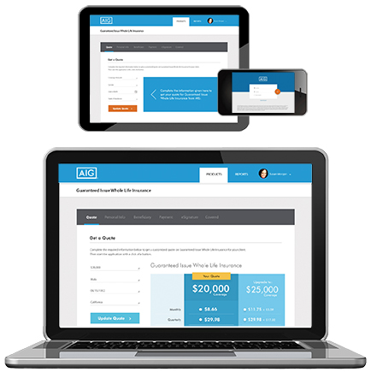
GIWL technology platform
Strategy and Process
Designed to enable a simple, straight-through electronic sales and application process
Easy to use, responsive design – works on tablet and mobile devices
Provides simple quoting with upsell suggestions
Includes all forms, disclosures, etc., needed at point of sale
Validates all information is correctly completed – no incomplete applications
Validates payment information in real time helping agents maximize productivity
Notes:
Next, lets talk about the technology platform. This platform has been designed to enable a simple, straight-through electronic sales and application process.
It is easy to use with a responsive design that works on tablets and mobile devices and of course desktop and laptop computers.
It provides simple quoting with upsell suggestions which we will demonstrate in a moment.
It includes ALL forms and disclosures needed at the point of sale.
It validates all information is correctly completed which means no incomplete applications can be submitted which eliminates all NIGO issues.
And it validates everything in real time. It validates payment information helping you maximize productivity and making sure that when we submit the application via the electronic process everything is going to be complete.

Slide 11
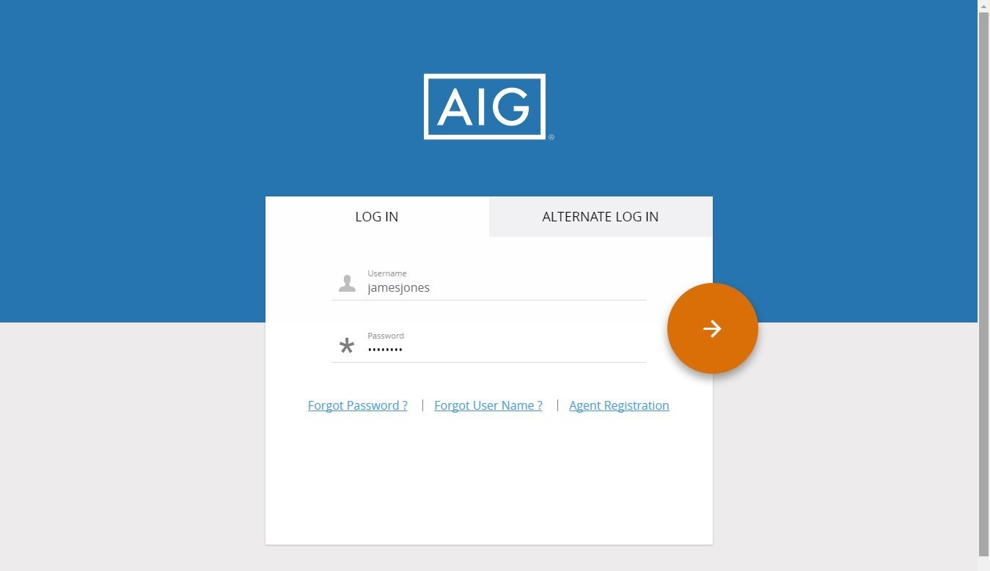
Self registration – one time process
Notes:
Let’s walk through some of the technology that is used. There is a one-time self registration process that needs to be completed in order to access the site. You, the agent, will receive the link to this site in the welcome letter or email that we send to you once you are appointed. You will need an agent number to register for the site. Please understand, it may take a short amount of time after the appointment for your agent number to be active and recognized on the site.
Click
In order to do the on time registration click the “Agent Registration” link on the right hand side.

Slide 12
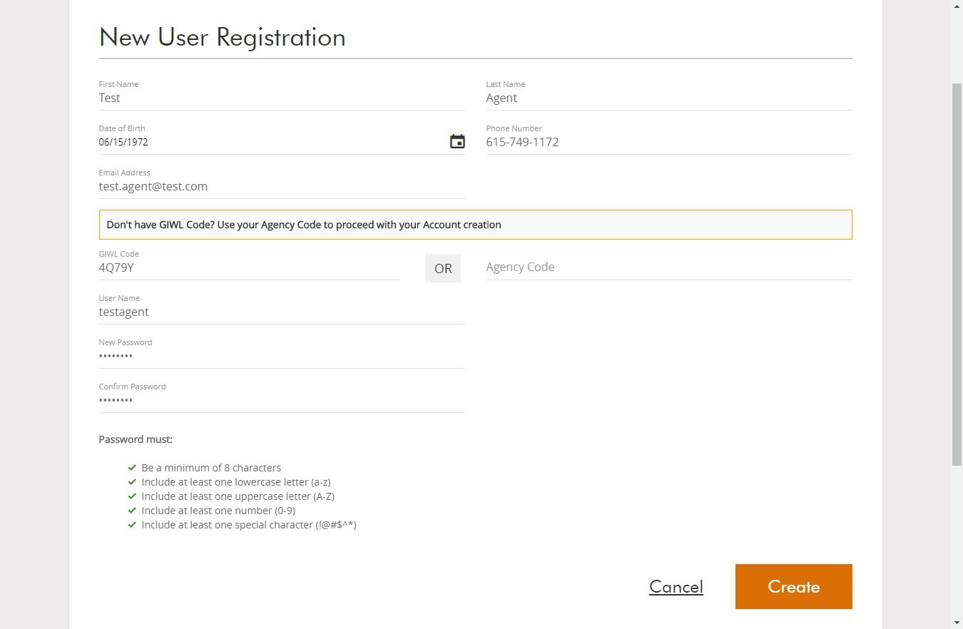
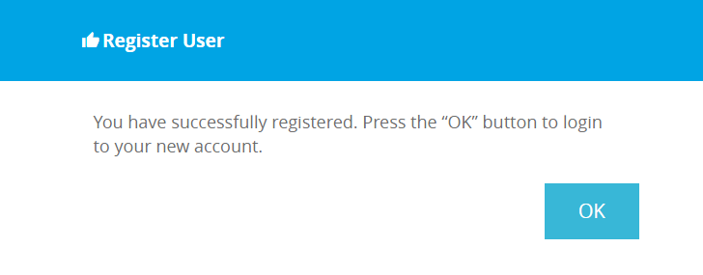
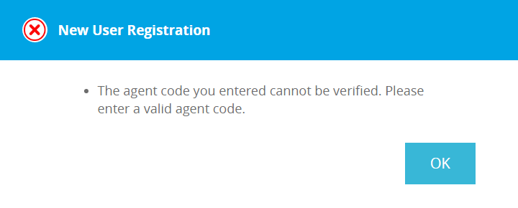
Self registration – one time process
Notes:
After you click the link, you will need to complete the New User Registration with your first and last name, date of birth, phone number, and email address.
Then, you will need to enter that GIWL code, create a username and create a password. Note that if you do not have your GIWL code you may use your agency code to proceed with your account registration.
After you have entered that information click Create in the bottom right corner
Click
You will either get a message that says “The agent code you entered cannot be verified. Please enter a valid agent code.”
Click
Or, “You have successfully registered. Press the OK button to login to your new account”.
If you get the first message, make sure you entered your code correctly. If it is entered correctly, remember, it can take a short amount of time after you get your code for it to be recognized on the site. So be patient and try again at a later time.

Slide 13
Log in
Notes:
After you have registered, you will enter the site through this login screen. Simply enter your username and password to get in.

Slide 14
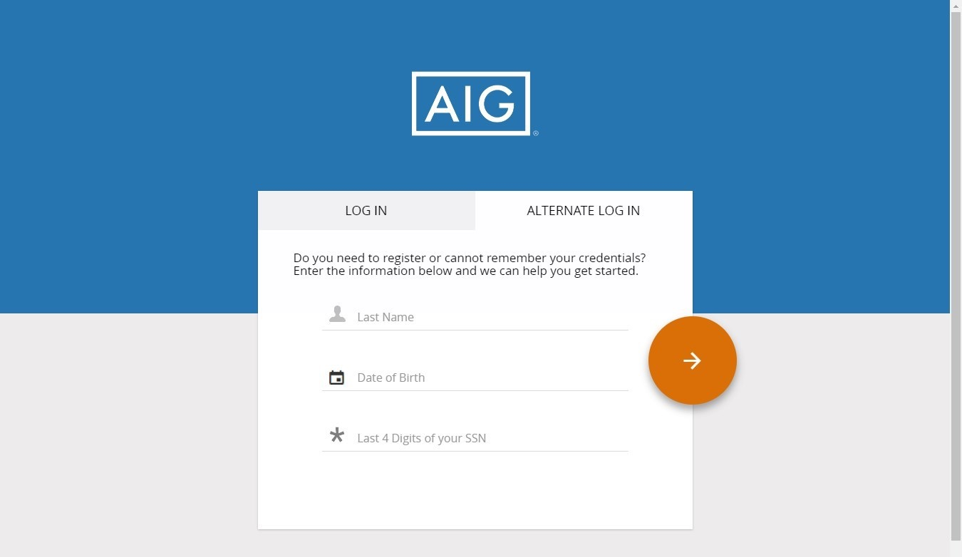
Alternate log in
Notes:
You may also click on Alternate Log In if you don’t have a username and password to enter the site.
Enter all three required elements (Last name, Date of birth, and the Last 4 digits of your SSN). This alternate login will check against our databases for a couple of things.
First, its going to check and see if you are valid for selling and have a GIWL account. If so, it will log you in.
Second, if the system check recognizes that you are valid for selling but DO NOT have a GIWL account already set up it will ask you to create a username, password, and any other missing elements to create a GIWL account.
And finally, if the system sees that you are NOT valid for selling and DO NOT have a GIWL account you will see an error message indicating that you are not eligible to sell the product.
Alternate Log In Scenario #1 – will check against SalesForce and GIWL DB to see if you are valid for selling and have a GIWL account; then it will log you in.
Alternate Log In Scenario #2 – will check against SalesForce and GIWL DB to see if you are valid for selling and DO NOT have a GIWL account; it will ask you for a Username, Password and any other missing elements to create a GIWL account.
Alternate Log In Scenario #3 – will check against SalesForce and GIWL DB to see if you are NOT valid for selling and DO NOT have a GIWL account; the system will present an error message stating you are not eligible to sell the GIWL product.

Slide 15
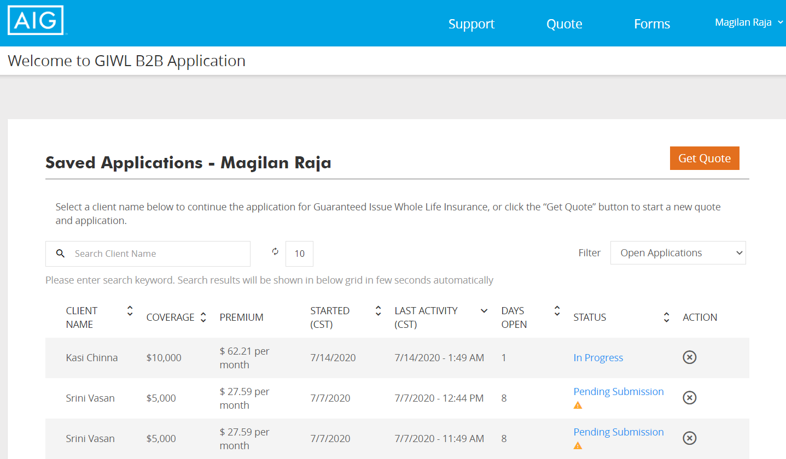
Landing page
Notes:
Once you log in it will take you to this landing page where you can see a list of your saved applications. You can see the status of each application as well as get into the ones that are saved, but not yet submitted.
But, from a navigation standpoint, there are 4 tabs in the upper right corner of the page. You have a Support tab, a quote tab, a forms tab then you will see your name and a drop down menu.
To run a new quote, click on Get Quote (or you could click on the quote tab at the top).

Slide 16
Hassle-free Whole Life Insurance coverage
Guaranteed Issue Whole Life insurance from American General Life Insurance Company is a simple and affordable life insurance policy designed to help cover expenses like medical bills, credit card debt or funeral costs, and can help protect your loved ones from future financial burdens.
With Guaranteed Issue Whole Life insurance, if you’re age 50-80, you can’t be turned down for health reasons, and you can receive permanent life insurance without having to qualify for coverage based on your health. The benefits from this guaranteed issue whole life insurance can lend a helping hand for your loved ones during a difficult time.
Notes:
(read slide)

Slide 17
Hassle-free Whole Life Insurance coverage
Guaranteed Acceptance
No Medical Exam
Up to $25,000 in Coverage
Living Benefits are included – at NO EXTRA COST
(Subject to state approval)
Chronic Illness
Terminal Illness
Guaranteed level premiums paid may exceed amount of coverage. For an estimate of the year the premiums may exceed the amount of coverage, divide the face amount by the annual premium.
Required premium payments stop at or before age 90.
Developed for ages 50-80.
Notes:
(read slide)

Slide 18
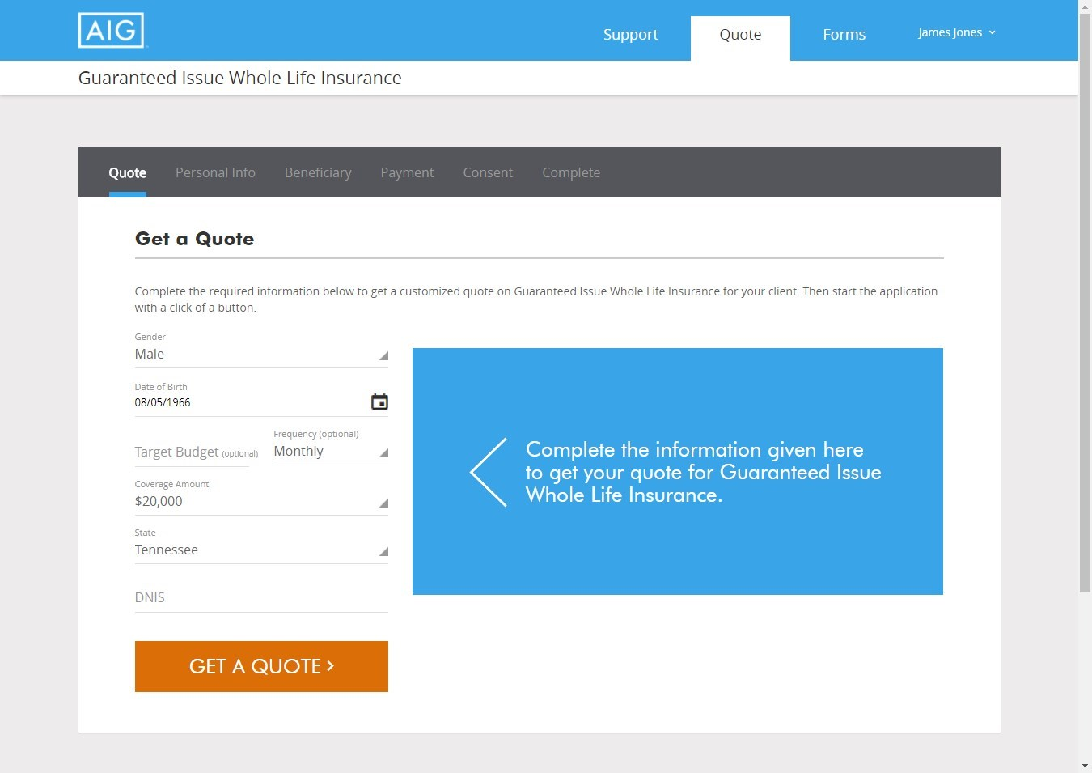
GIWL quote process
*Not an actual case and is a hypothetical representation for illustrative purposes only.
Notes:
So let’s say you want to go in and obtain a quote. Regardless if you are doing a paper application or using the electronic process you will need to log into this site to obtain a quote. You will need to get the quote first before you submit an application.
This will bring us to our initial screen to obtain a quote. As you can see it is pretty easy. You will need to enter the gender, date of birth, coverage amount, and issue state. You also may enter a targeted budged and payment frequency if you would like.
After you have entered the required information, click Get a Quote.

Slide 19
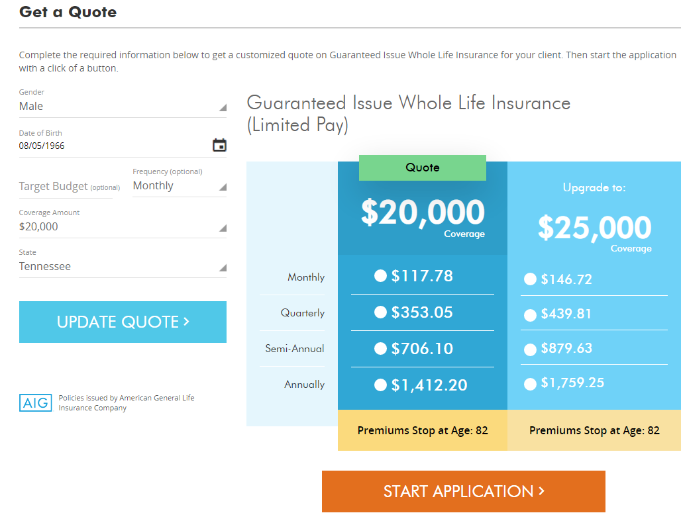
GIWL quote process
*Not an actual case and is a hypothetical representation for illustrative purposes only.
Notes:
So, you see in the middle that $20,000 was selected. It then provides the payment amount for the 4 payment frequencies. But what this also does, is provide you the opportunity to upsell. It will give you the next $5k increment in death benefit coverage. So next to the $20k that we input it also provides the pricing should they purchase $25k instead.
Mr. Client, if you wanted to instead purchase $25k of coverage it will cost you around $28 more per month. It’s a great way to provide a different option for the client.
You will also notice foe each option it provides you the age at which the premiums stop. In this example, the premiums stop at age 82.

Slide 20
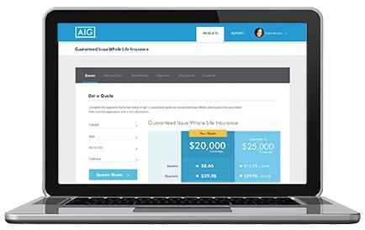
Application process options
There are two ways to complete an application:
Paper Forms
Can be printed out, filled out by hand and faxed into AIG
Electronic Order Entry
Filled out online with instant submission and, in most cases, instant processing
Notes:
There are 2 ways to complete the application. Regardless of which way you choose, you must first log into the site to obtain the quote.
You can complete a paper application which can be printed out, filled out by hand and faxed into AIG.
Or, you can use our electronic order entry where it is filled out online with instant submission and, in most cases, instant processing.

Slide 21
PAPER Application Process
Notes:
Let’s first look at the paper application process.

Slide 22
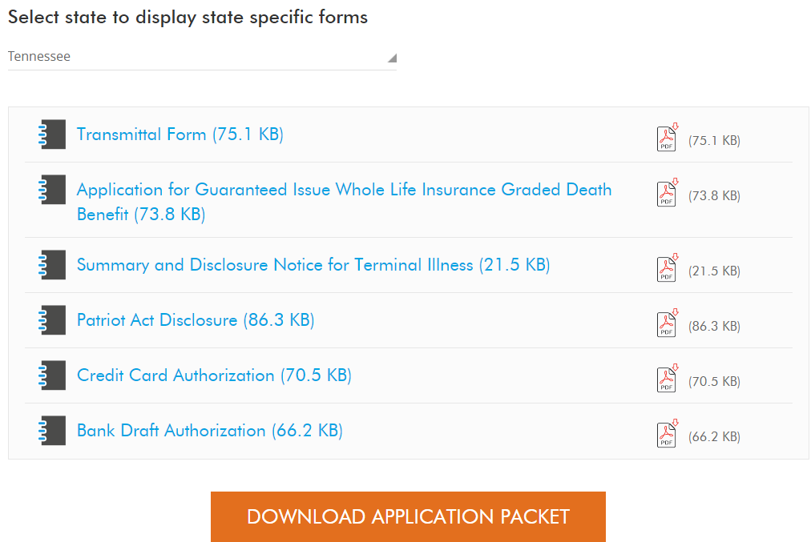
Download application packet
Notes:
Once you have gone in and obtained your quote, you will need to get all of the paperwork to complete.
You do that by clicking Forms at the top of the initial landing page.
Once you click Forms, you want to scroll down to the bottom and this is where you will obtain the paper forms that you need to download and print.
Click the state drop down menu and choose the correct application state.
Once the correct state is selected it will give you all the necessary forms you need for that state.
You can click on each of those form individually to print them off, but more than likely you will click the Download Application Packet button that will bundle all the necessary forms together that can be printed and filled out by hand.

Slide 23
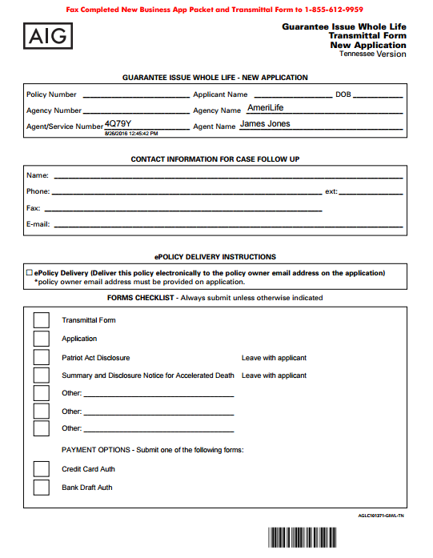
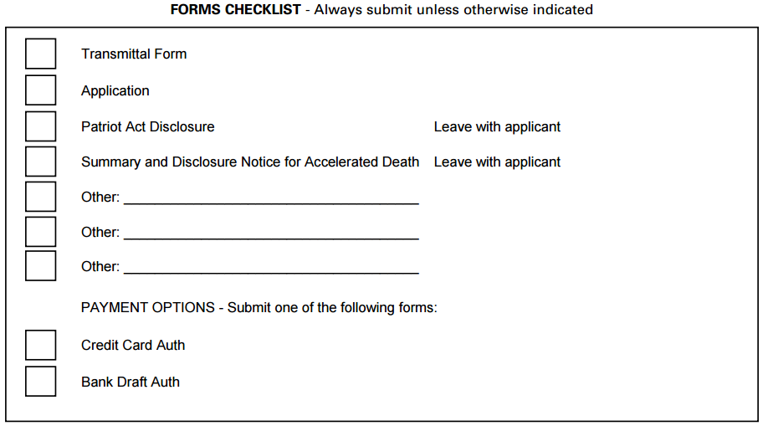
Application packet
Notes:
The first form you will have is the GIWL application form which is the transmittal form.
Click
You will notice at the top, in red, that it says to fax the completed new business app packet and transmittal from to the number that is provided.
Click
In the top section you will also notice that it pre prints your agency name, agent number, and your name. It preprints this information based off you logging into the site then downloading the forms.
Click
Also at the bottom is a forms checklist. It is important that you are utilizing this to ensure you are completed all of the necessary paperwork that is needed when you fax it in.
This transmittal form MUST be included with all of the other paperwork when it is faxed in and you will want to make sure that it is submitted on top.

Slide 24
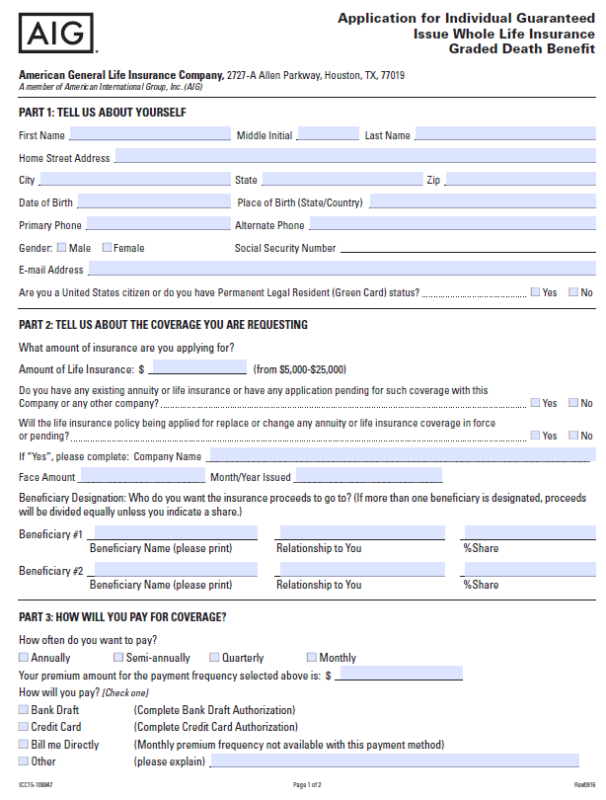
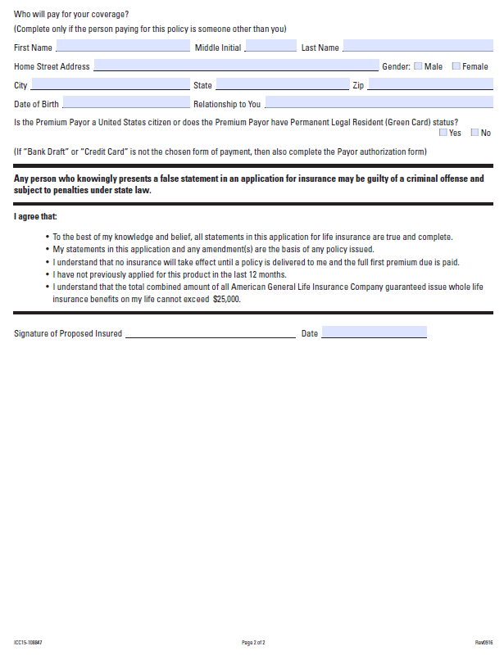
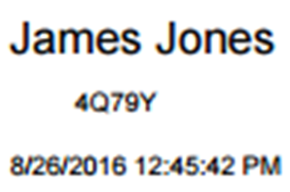
GIWL paper application
All prescreening is to be done by the Distribution Partner to ensure all information is correctly submitted.
No = Ineligible – Do not send to AIG
No = Ineligible – Do not send to AIG
Yes = Ineligible – Do not send to AIG
Bank draft or credit card is required for this product.
Notes:
A few things to note in regards to the paper application:
Click X2
You will want to make sure everything is filled out correctly before you submit it. Since you are not using the electronic app system none of this will be checked automatically for you before it is submitted.
There are a few key question to be aware of how the client answers them that is going to determine eligibility for this product.
Click X2
The first one is Are you a United States citizen or do you have Permanent Legal Resident Green Card Status. If they do not and answer NO they are ineligible for the GIWL product, you would not want to send that in then to AIG.
Click X2
Next, I will point out the question, Will the life insurance policy being applied for replace or change any annuity or life insurance coverage inforce or pending. If they answer yes to that, once again they are ineligible and do not submit the application to AIG. Replacements are not allowed with the GIWL product.
Click X2
From a payment standpoint, there are simply 2 options that are available. Either bank draft or credit card. One of those needs to be chosen to submit the application.
Click X3
On page 2 of the application, and it is only a 2 page form, there is another question to be aware of. Is the Premium Payor a United States Citizen or does the Premium Payor have Permanent Legal Resident Green Card Status. If they are not, then once again they are not eligible. Foreign nationals are not allowed to be payors on this product.
Click X2
You will also notice on the application, at the bottom by the signature area, your information is pre printed on it with name, agency number and it is timestamped with current date and time. Once again that is pulling the info from the site that you downloaded the forms from.

Slide 25
Fax process flow
Get Quote
Download Forms
Complete Forms with Applicant
Prescreen forms for completeness and product eligibility
Fax prescreened forms with GIWL Transmittal Form to AG
Upon receipt at AG
Forms will be reviewed for completeness
Policy will be data entered and issued
Get Paid
Notes:
The process of faxing it in is pretty simple. We already walked through getting the quote and downloading the forms. You need to complete the forms with the applicant.
Again, this is important, please prescreen the forms for completeness and product eligibility.
Then fax them in with the transmittal form to the number that is at the top of that form.
Once we receive them they will be reviewed for completeness and the policy will be data entered and issued and then commissions will be paid.
So that is the paper application process.

Slide 26
ONLINE Application Process
Notes:
A more streamlined process is the online application process.
You can complete an electronic application one of 3 ways. We will walk through each of those ways with you now.

Slide 27
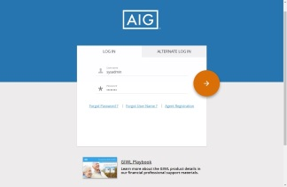
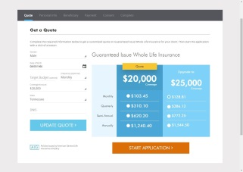
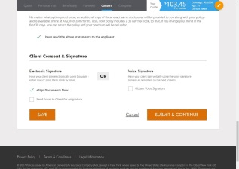
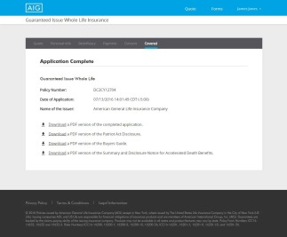
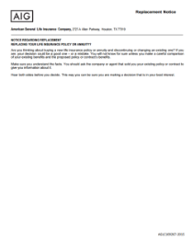
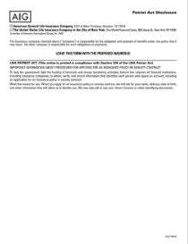
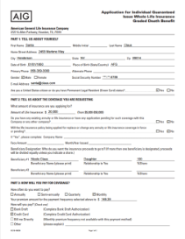
Electronic process flow
1
2
3
Agent Login
Prepare Quote
Obtain Quote
4
5
Fill Out Application
Download Completed Application Copy
Get Paid!
Notes:
You can see, its pretty simple from a process flow standpoint. You first need to login to the site, prepare then obtain the quote, fill out the application electronically and submit it. Once that is done you will have the opportunity to download the completed application copy, then you get paid!

Slide 28
GIWL online application process
Notes:
So let’s look at this process. Once again, we have logged back into the site.
You will click quote at the top, just like we looked at before.

Slide 29
GIWL online application process
*Not an actual case and is a hypothetical representation for illustrative purposes only.
Notes:
The we get to the quote screen. We have already seen this. We will click on get quote.
Reminder: Product Requirements
Insured must be Owner
Payor can be different than Insured
Social Security number will be required
Only one policy per Owner/Insured in a twelve-month period
Insured can get no more than $25k total in GI insurance from American General
No replacement or conversion into this product allowed
Payment options include bank draft, credit card, and social security debit card (for initial and recurring); able to set delayed billing and specify date.

Slide 30
GIWL online application process
*Not an actual case and is a hypothetical representation for illustrative purposes only.
Notes:
And that brings us to our quotation screen. Let’s assume the upsell worked and the client did decide to purchase the $25k of coverage for $146 per month.
Now we have gone to here before, but we clicked on forms at the top to download the application. But now, we are going to do the online application instead. So, click on the premium mode they want
Then click on the Start Application at the bottom.

Slide 31
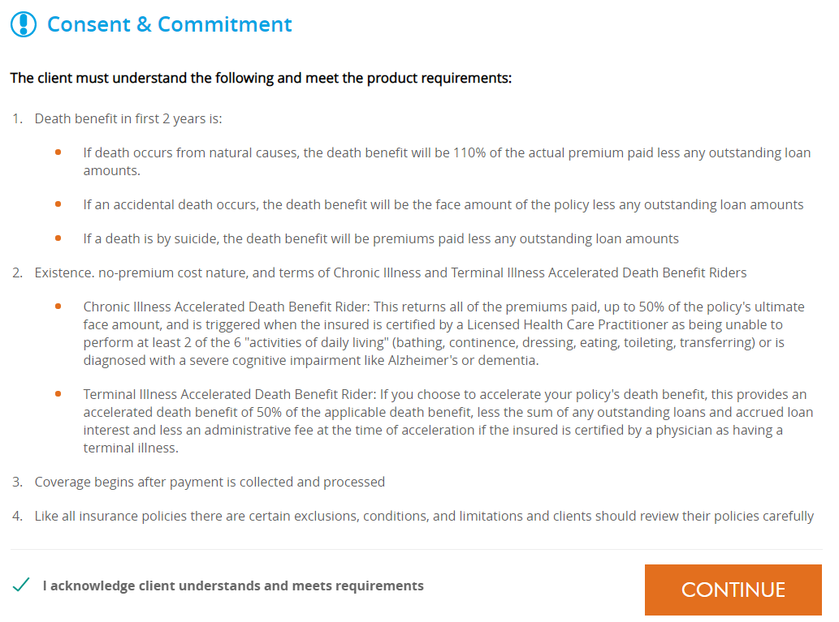
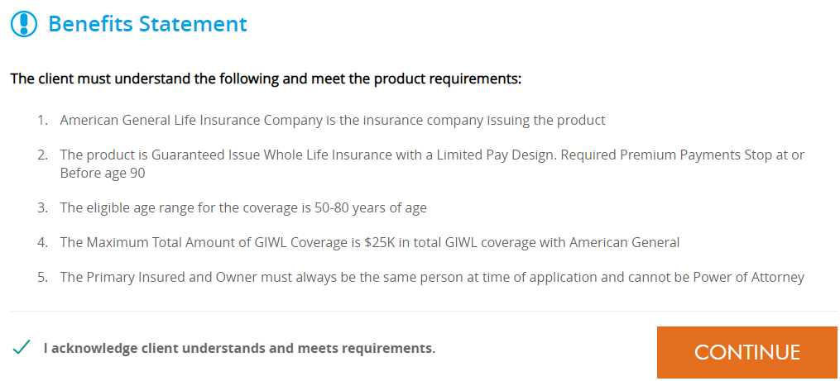
GIWL online application process
Notes:
Once you click on start, you will see a benefit statement where the client must understand the following and meet the product requirements. You will want to cover that with the client. You have to acknowledge the client understands and meets the requirements at the bottom
Then click Continue to move on.
Click
Then another Consent & Commitment is populated that the client again must understand and meet the product requirements.
Once the client has acknowledged, check the box at the bottom, then click continue to move on.

Slide 32
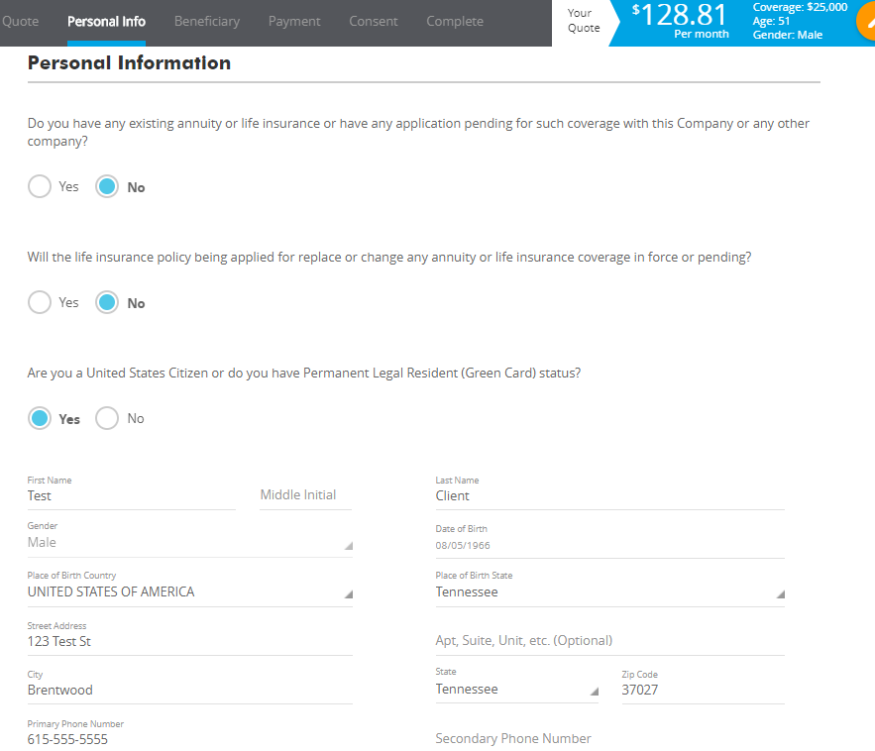
Personal information
Notes:
So now, it takes us into the application. You will see some tabs at the top: personal info, beneficiary, payment, consent, and complete. All of these sections will need to be completed in order to submit the application.
The first 3 questions in the Personal Information section are those key questions that I highlighted for you on the paper application. I have got the correct answers selected already: No, No, and Yes. (Please make sure that these are answers provided by the client). If you chose any of the other answers it will tell you to not proceed with the application, that the client is ineligible.
At the bottom of this section you will be inputting the client’s information.

Slide 33
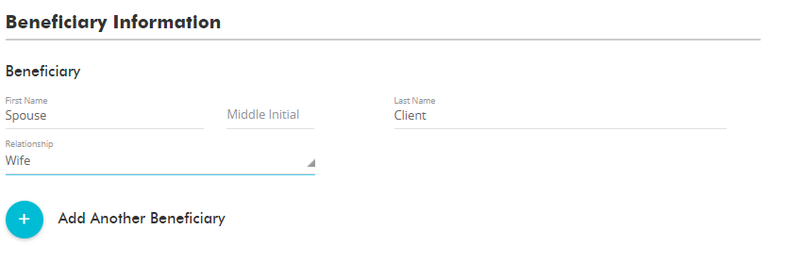
Beneficiary information
Notes:
All you will do now, is simply keep scrolling down. The next section is the beneficiary information section. You will enter their information here. You can also add additional beneficiaries by clicking the PLUS circle and split the DB however you would like between them.
2 primary beneficiaries can be submitted at the time of application. If you wish to add more you may do so after the policy has been placed inforce.

Slide 34
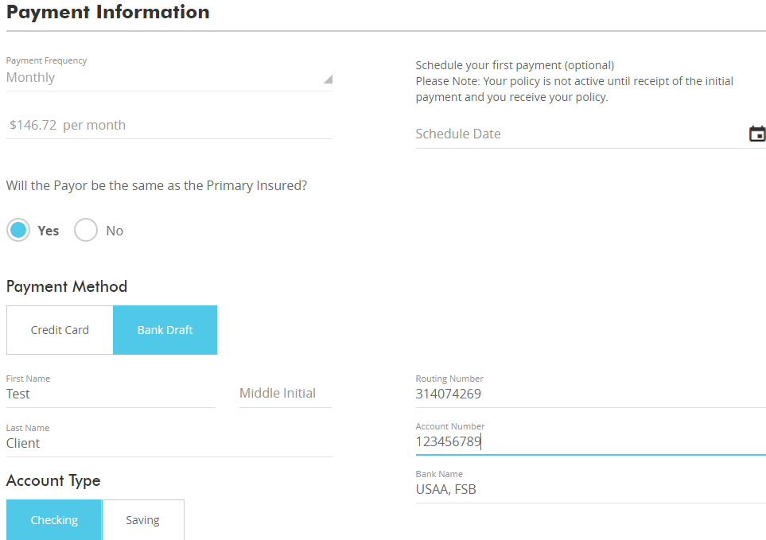
Payment information
Notes:
The next section is the payment information. I have bank draft selected. Credit card is also an option. Everything is validated in real time. When you put the credit card information in here it is going to make sure that the card is valid. If an item is incorrect it will show up as red.
You can also set a delayed billing date here in the Schedule Date box.

Slide 35
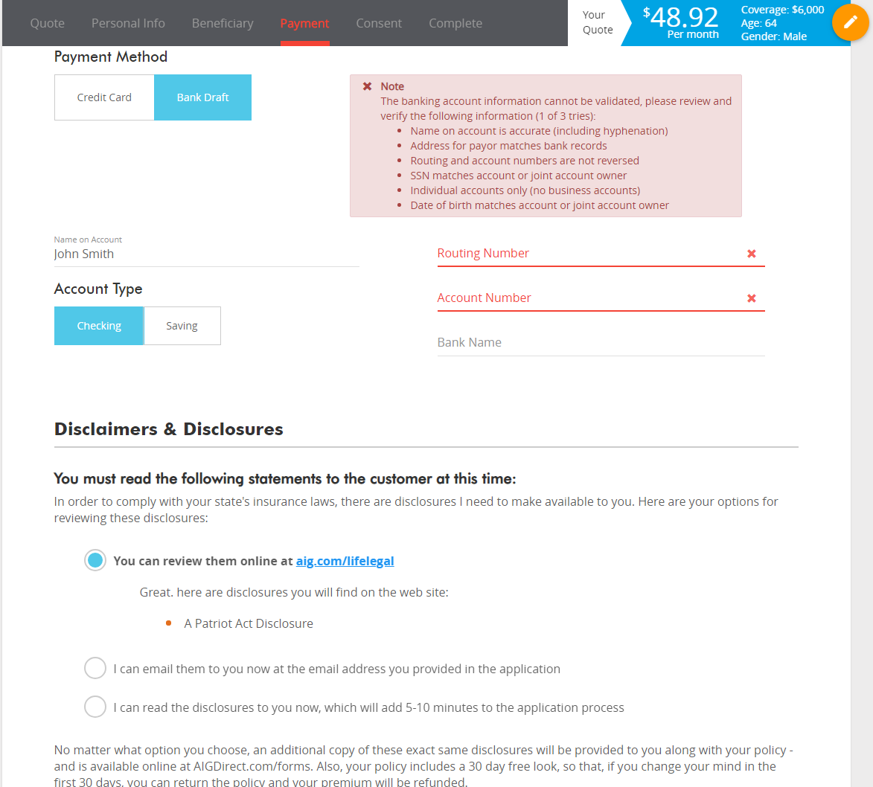
Payment information
Notes:
When entering the bank draft information, the system automatically does a GIACT verification of the bank information entered. This process will help improve client satisfaction by placing coverage inforce quicker and will reduce your post-application client follow-up.
If any of the bank account information is entered incorrectly you will receive the “Note” on your screen indicating some piece of the information cannot be validated.
CLICK
The note provides the most common types of data that prevents these checks from going through appropriately. Please review all of the information and try again.
NOTE: You get 3 tries to get the bank draft information correct.

Slide 36
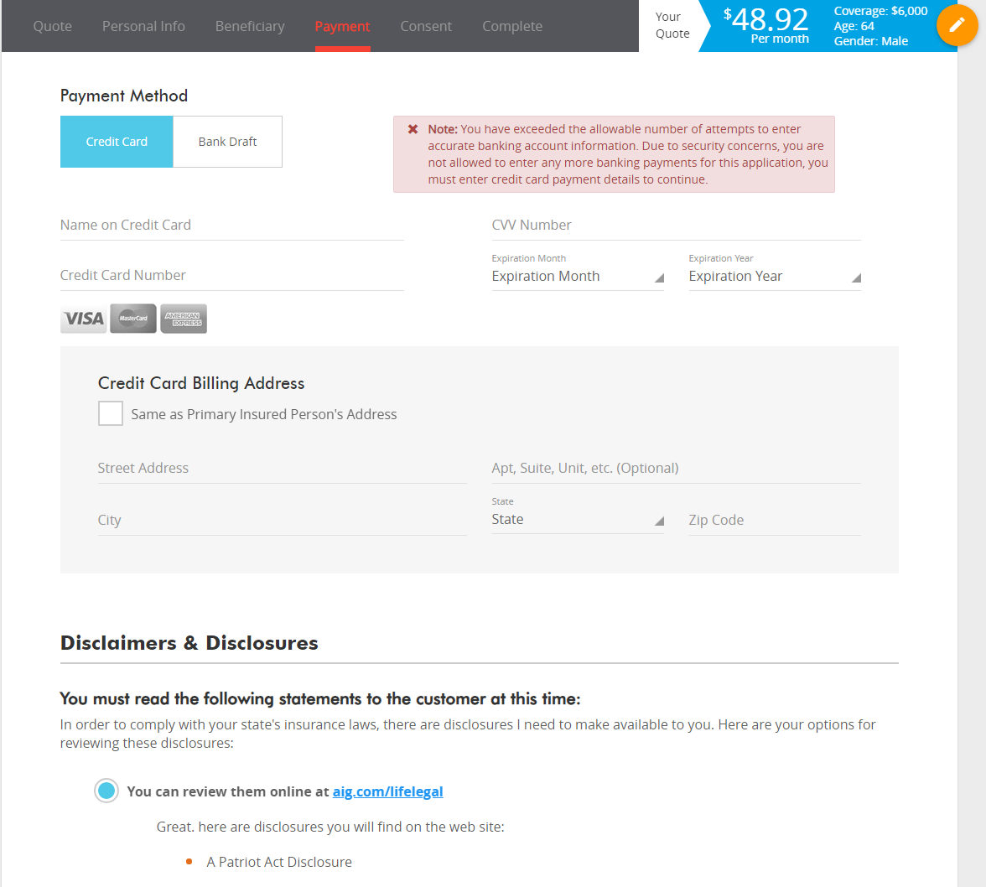
Payment information
Notes:
After the third incorrect attempt at entering the information the note will read:
You have exceed the allowable number of attempts to enter accurate banking account information. Due to security concerns, you are not allowed to enter any more banking payments for this application, you must enter credit card payment details to continue.
At that point, the application automatically switches the payment method to Credit Card in order to continue.

Slide 37
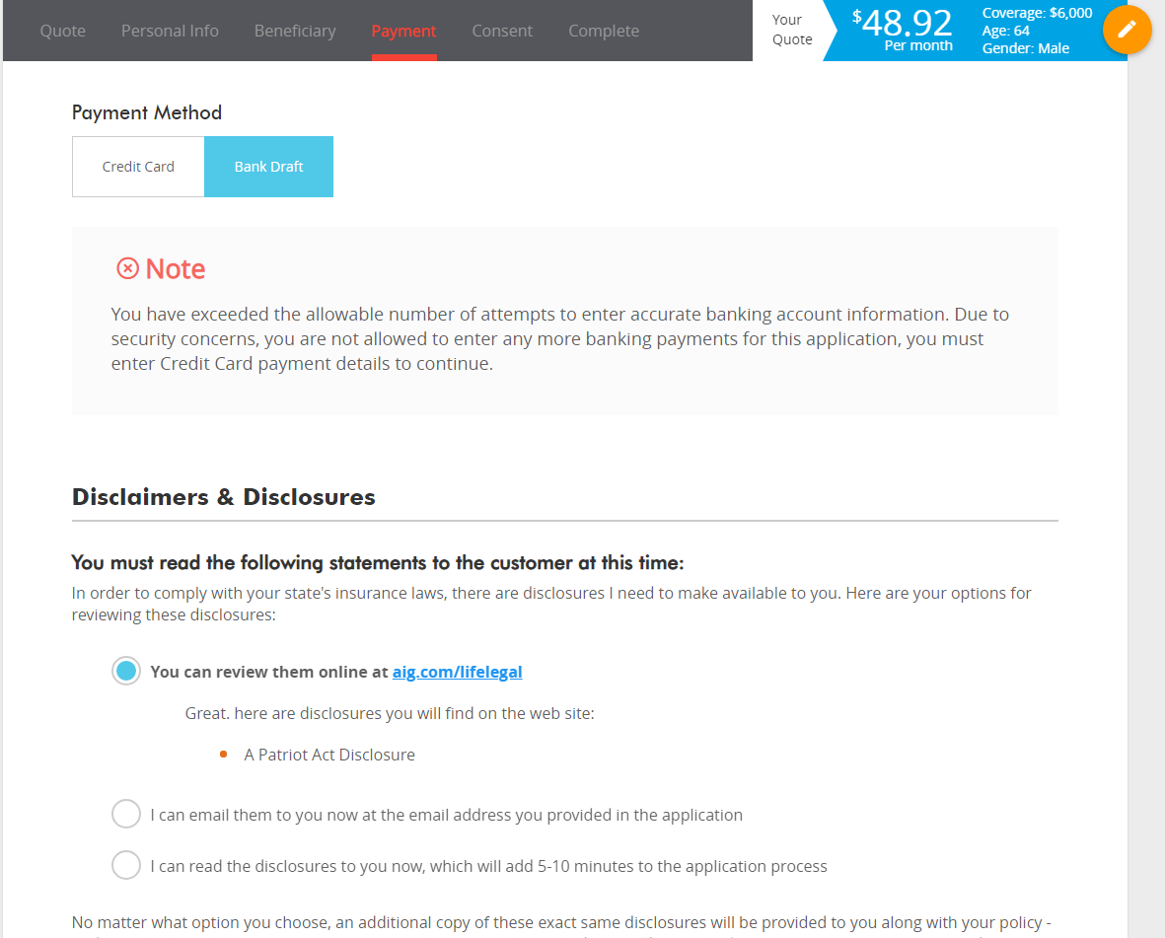
Payment information
Notes:
After the third failed attempt, if you try to go back to the Bank Draft section you will receive the Note listed on the screen:
You have exceeded the allowable number of attempts to enter accurate banking account information. Due to security concerns, you are not allowed to enter any more banking payments for this application, you must enter credit card payment details to continue.
Should you discover the client’s information discrepancy after the third failed attempt and they prefer to pay via bank draft, you must start a new application to try and enter bank account information again.

Slide 38
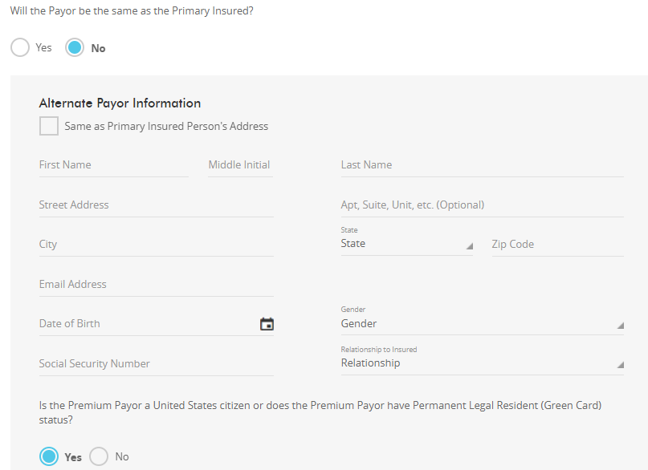
Payment information
Notes:
If you indicate “No” to “Will the Payor be the same as the Primary Insured?” You will have additional details to complete for the Alternate Payor.

Slide 39
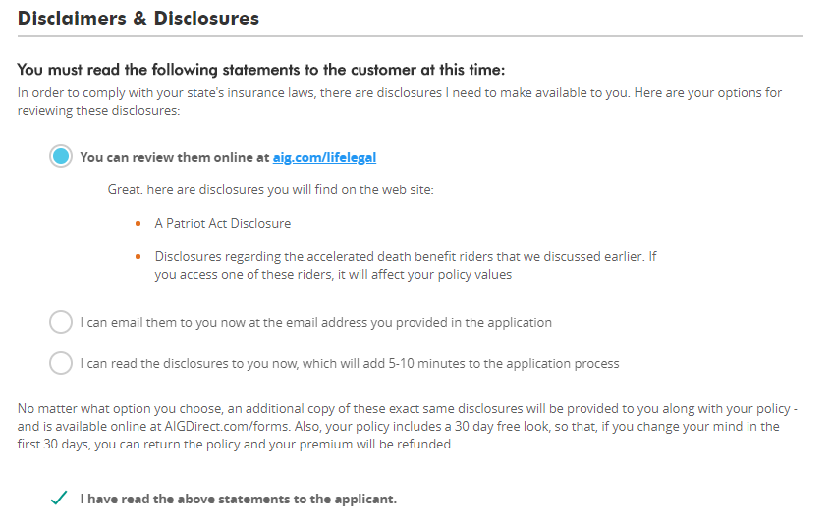
Disclaimers & disclosures
Notes:
You must select one of the 3 options for the disclaimers.
They can review them only, you can email them to the client, or you can read them to them, verbatim. After that is done, check that you have read the above statement to the applicant.
That is it from an input perspective. Next we will cover the different signature methods, but first you will notice there are 2 buttons at the bottom: Save and Submit & Continue.

Slide 40
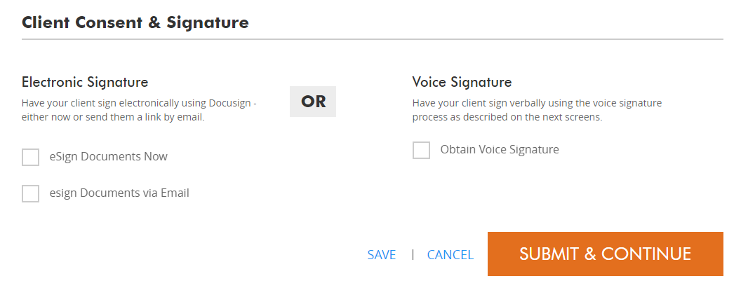
Saving the application
Notes:
If you wanted to, you could Save it and stop the application at this point and you will be able to go back into it later.
If you save it, it will be placed it in that area we talked about before, in your Dashboard. Which can be accessed in the drop down menu in the upper right hand corner of the screen.

Slide 41
Saving the application
Notes:
If you save it, it will be placed it in that area we talked about before, in your Dashboard. Which can be accessed in the drop down menu in the upper right hand corner of the screen.

Slide 42
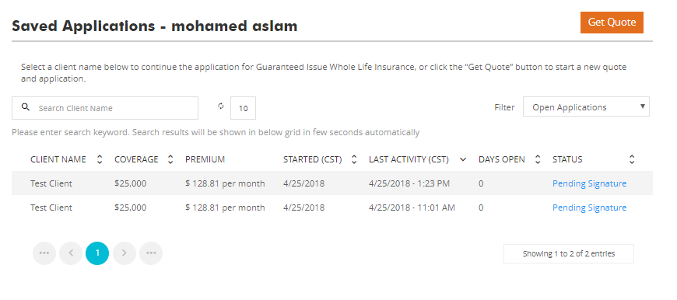
Saving the application
Notes:
If we go into the Dashboard area and you had saved this client, it will list all of your saved ones in there for you. You can see the names, the coverage amounts, premium, when it was started, the last time there was anything done to it, how long it has been open, as well as the status.
Note: If you have pending clients, the dashboard will be the first page that appears when you first log in.
But for today’s purpose, let’s not save it. Instead we will click Submit & Continue and look at the docusign process.

Slide 43
eSign Documents Now
Notes:
The first method is to eSign Documents now.

Slide 44
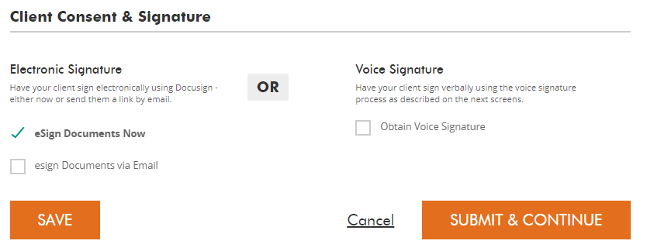
eSign documents now
Notes:
Check eSign Documents Now then click Submit and Continue for this method.

Slide 45
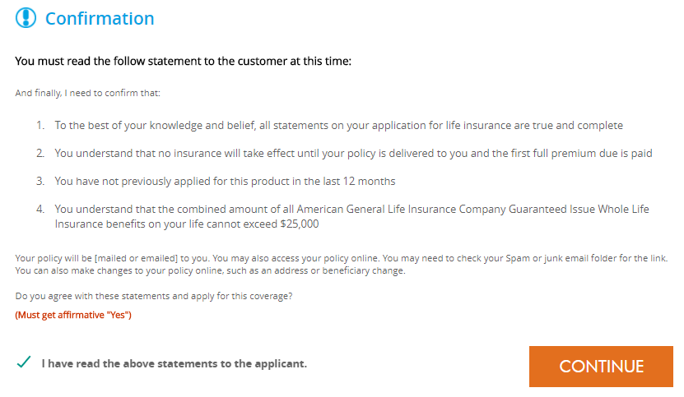
eSign documents now
Notes:
Once you have decided to eSign Documents now, you will need to read the following message to the applicant and check agree before clicking continue.

Slide 46
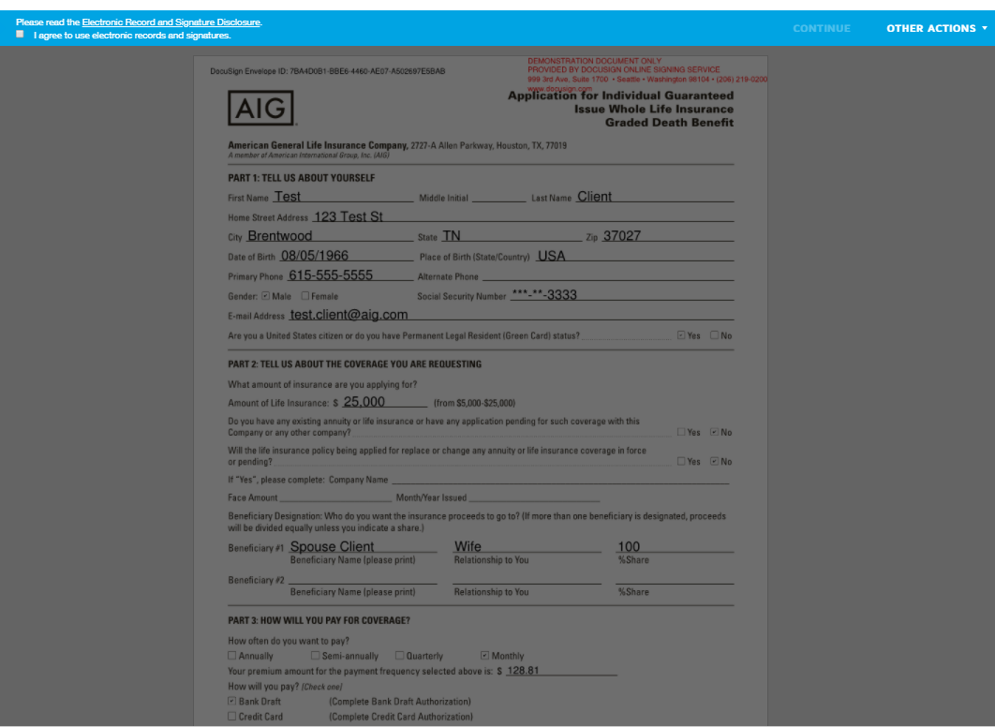
eSign documents now
Notes:
Once we submit and continue, you will need to agree to use the electronic records and signatures.
Once you click there, you can click Continue to bring up the filled out, PDF version of the application.

Slide 47
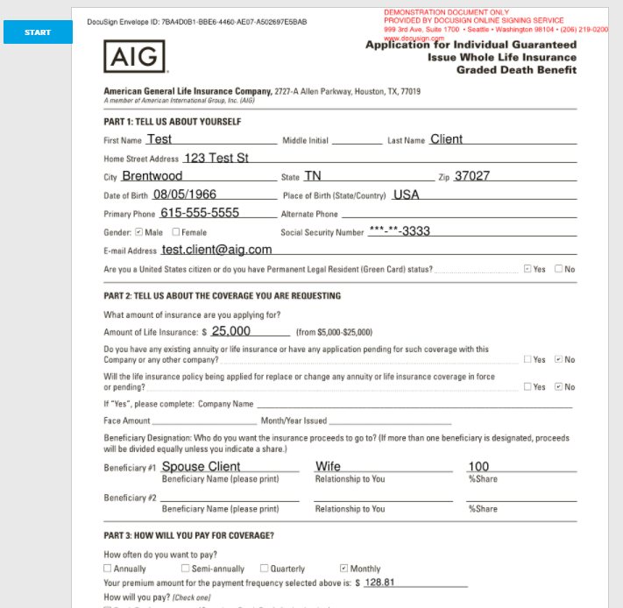
eSign documents now
Notes:
To get the signatures of the client that applied you need to click on Start towards the top.

Slide 48
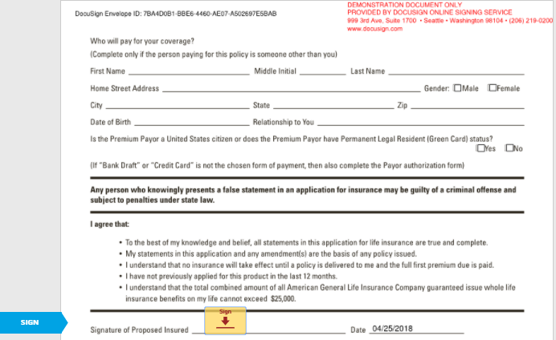
eSign documents now
Notes:
That will bring you to the first signature area.
Click on the little sign red arrow there

Slide 49
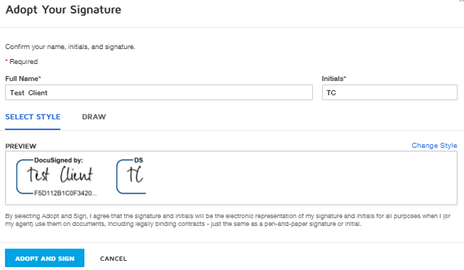
eSign documents now
Notes:
And that will bring up your DocuSign options. DocuSign will prepopulate signatures for you there that you can utilize simply by clicking “Adopt and Sign”. You will notice there is a Draw option as well. If you are on a phone or tablet you can have the client use their finger or a stylus to sign it with that option.

Slide 50
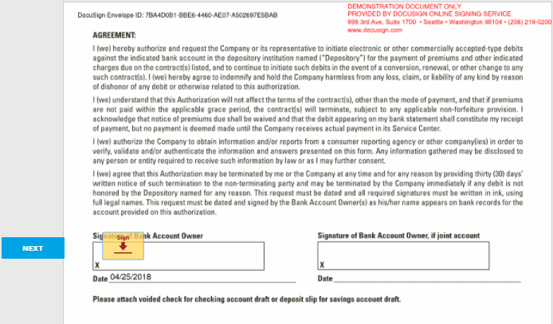
eSign documents now
Notes:
If you click Adopt and Sign that is going to populate all the necessary signatures in the application. Once that is complete you click on Finish and that ends the signature process.

Slide 51
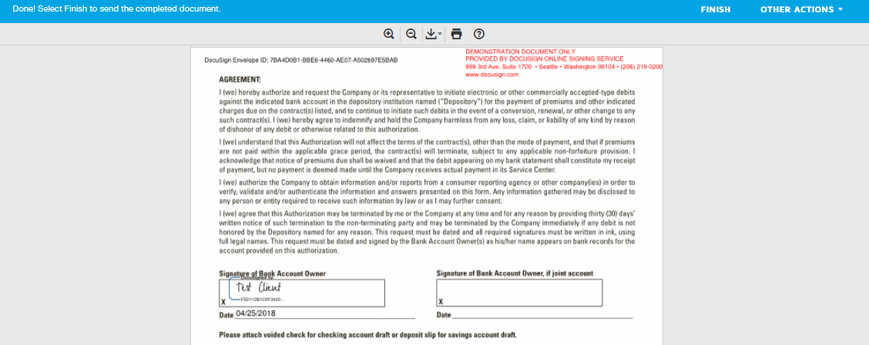
eSign documents now
Notes:
If you click Adopt and Sign that is going to populate all the necessary signatures in the application. Once that is complete you click on Finish and that ends the signature process.

Slide 52
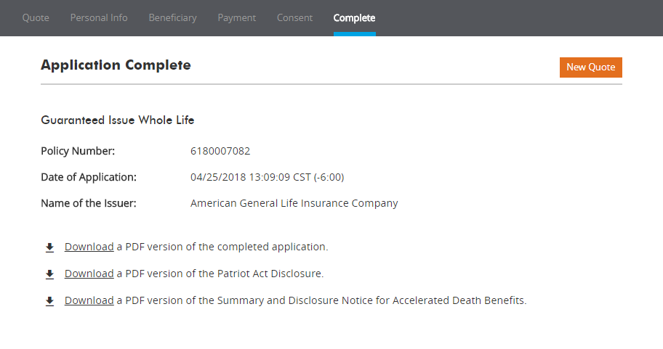
eSign documents now
Notes:
After each of those steps you will be notified that the application is complete and be provided the option to download the completed forms for you and your clients records.

Slide 53
eSign Documents via Email
Notes:
Another way to complete the application is to eSign Documents via Email.

Slide 54
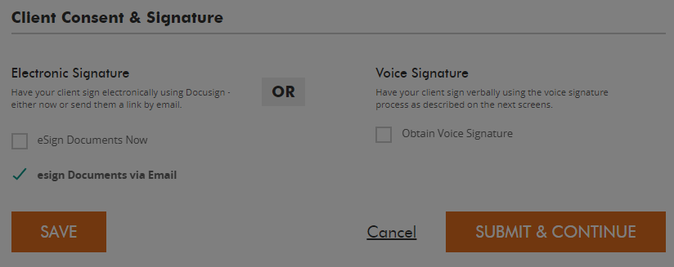
eSign documents via email
Notes:
Choose eSign Documents via email then click Submit and Continue for this method.

Slide 55
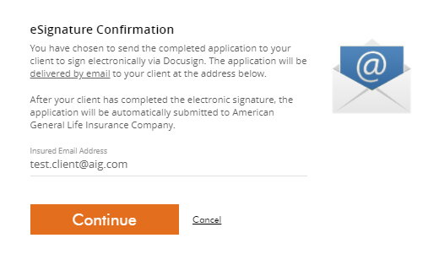
eSign documents via email
Notes:
After selecting that submission method, you will be given an eSignature Confirmation screen that outlines the details of this process as well as the email address of the insured that the information is going to go to.
Click Continue to move on.

Slide 56
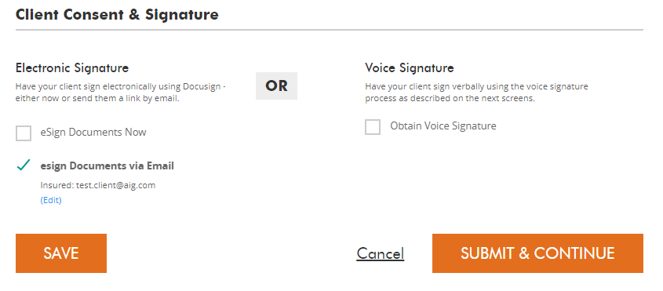
eSign documents via email
Notes:
After that, you will be taken back to the Client Consent & Signature screen where you need to click Submit and Continue.

Slide 57
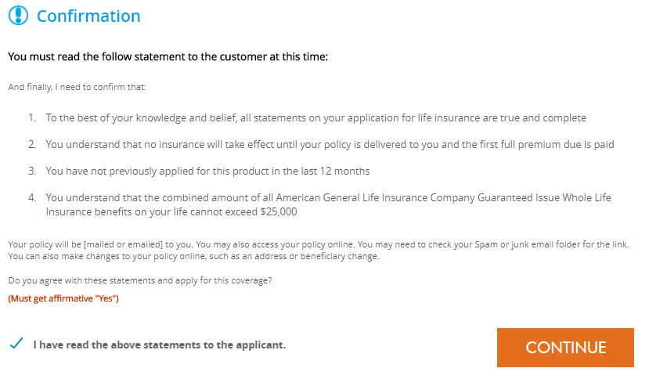
eSign documents via email
Notes:
You then will see the confirmation screen again where you must read the statements to the customer, check that you have done so, then click continue.

Slide 58
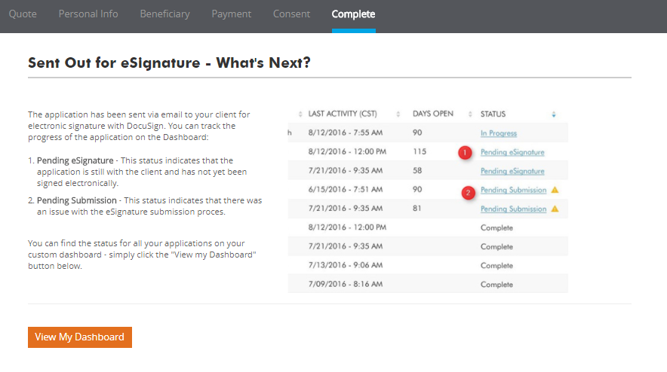
eSign documents via email
Notes:
Finally, you will get the details about what is next.
This screen notifies you that the application has been sent via email to your client for electronic signature and shows you how to track the progress of the application on the Dashboard, all the way up until the process has been completed by the client.

Slide 59
Online Application Process Voice Signature
Notes:
The final way to complete the online application is by using a voice signature. So if you utilize or if you have voice recording with your firm this would also be a viable option for obtaining the signatures.

Slide 60
Obtain voice signature
Notes:
For this method, select Obtain Voice Signature then click Submit and Continue.

Slide 61
Obtain voice signature
Notes:
You must again read these statements to your customer at this time, check that you have done so, then click Continue.

Slide 62
Obtain voice signature
Notes:
Because of the signature type, there is another voice signature disclosure that you must read to the customer, check that you have done so, then click continue.

Slide 63
Obtain voice signature
Notes:
Here are more disclosures now for the voice signature process that have to be competed and read to the customer at this time.
You also see there is an area you are going to need to enter the Voice Signature Reference ID which links that recorded voice signature to this application for recordkeeping and legal purposes.
Once you have that, click Continue and you will have another statement that has to be read to the customer at this time. Check the box, click continue and it is now complete and you will end up at the same screen where you can download the application.

Slide 64
Obtain voice signature
Notes:
The final step in this process shows that the application is complete and provides links for you to download copies of the application and disclosures for you and your client.

Slide 65
Marketing material
GIWL Playbook: www.aig.com/GIWLPlaybook
Consumer Brochure
Producer Guide Rate Calculator Max. Payment Age
Agent Recruiting Flyer
Notes:
For additional information here are just a few of the valuable marketing materials for you. There is a consumer brochure, producer guide, a rate calculator and maximum payment flyer, as well as an agent recruiting flyer.
These pieces can all be found on the GIWL playbook at www.aig.com/GIWLplaybook.

Slide 66
State availability
Notes:
Here is a look at the state availability. Note that this product is approved in all states except , NY and Maine. Also note there are some rider approval differences where the chronic and/or terminal illness riders are not available in all states.

Slide 67
Doing business in PA?
If you are writing a case in PA and using the “Download—Fax in Process”:
Need to have the cash value figures for the PA Disclosure Form
Please use the following process:
Call 877-399-7747 option 1 to speak to a rep to get the figures
May also email the request to: internal.lifesales@aglife.com
Contact info is also listed on the GIWL website
If you are utilizing the electronic application process the DOES NOT apply. The system will automatically generate the required numbers for you.
Notes:
PA paper applications only using the fax in process.

Slide 68
QUESTIONS?
And thank you all for your time today.
Notes:
That’s it for today. I want to thank you all for your time. If you have any questions please don’t hesitate to reach out to us. Thanks again.

Slide 69
Important Consumer Disclosures Regarding Accelerated Benefit Riders
An Accelerated Death Benefit Rider (ABR) is not a replacement for Long Term Care Insurance (LTCI). It is a life insurance benefit that gives you the option to accelerate some of the death benefit in the event the insured meets the criteria for a qualifying event described in the policy. The rider does not provide long-term care insurance subject to California insurance law, is not a California Partnership for Long-Term Care program policy. The policy is not a Medicare supplement.
ABRs and LTCI provide different types of benefits. An ABR allows the insured to access a portion of the life insurance policy’s death benefit while living. ABR payments are unrestricted and may be used for any purpose. LTCI provides reimbursement for necessary care received due to the inability to perform activities of daily living or cognitive impairment. LTCI coverage may include reimbursement for the cost of a nursing home, assisted living, home health care, homemaker services, adult day care, hospice services or respite care for the primary caretaker and the benefits may be conditioned on certain requirements or meeting an elimination period or limited by type of service, the number of days or a maximum dollar limit. Some ABRs and all LTCI are conditioned upon the insured not being able to perform two or more of the activities of daily living or being cognitively impaired.
This ABR pays proceeds that are intended to qualify for favorable tax treatment under section 101(g) of the Internal Revenue Code. The federal, state, or local tax consequences resulting from payment of an ABR will depend on the specific facts and circumstances, and consequently advice and guidance should be obtained from a personal tax advisor prior to the receipt of any payments. ABR payments may affect eligibility for, or amounts of, Medicaid or other benefits provided by federal, state, or local government. Death benefits and policy values, such as cash values, premium payments and cost of insurance charges if applicable, will be reduced if an ABR payment is made. ABR payments may be limited by the contract or by outstanding policy loans.
Policies issued by American General Life Insurance Company (AGL), Houston, TX. Policy Forms: ICC20-20532, 20532, 20532-5, and 20532-10. Rider Numbers: ICC15-15200, 15200, 15200-7, 15200-10, 15200-35, ICC15-15201, 15201, 15201-7, 15201-9, 15201-10, and 15201-35. Issuing company AGL is responsible for financial obligations of insurance products and is a member of American International Group, Inc. (AIG). Guarantees are backed by the claims-paying ability of the issuing insurance company. AGL does not solicit business in the state of New York. Products may not be available in all states and product features and rates may vary by state. © 2021 AIG. All rights reserved.
AGLC200485 REV0221
Notes:
(Read Slide)

